Slide 1

Street View House Number Recognition
Department of Computer Science and Engineering
School of Electrical and Computer Sciences
IIT Bhubaneswar
Date : 25-04-2025
Deep Learning Project on
By
Sourav Makal-24AI06005
Dibyajyoti Nayak-24AI06012
Puvvula Nikhileswari-24AI06017
Polasani Likhitha Reddy-S25EC08002

Slide 2
Contents
Problem Statement
Dataset Description
Pre-processing
CNN Models
Custom Architecture
ResNet18
Results

Slide 3
Problem Statement
Recognition of street-level house numbers is a critical task for urban mapping, navigation systems, and infrastructure assessment.
In this project, we aim to develop a deep learning model that can accurately recognize multi-digit house numbers from real-world images using the Street View House Numbers (SVHN) dataset.
Goal
The goal is to automate visual number recognition in complex environments.

Slide 4
Dataset Description
The SVHN dataset is a real-world image dataset for developing models that recognize digits from street view imagery.
Images are in .png format with variable resolution and real-world distortions.
Each digit in the image is labeled and has a bounding box stored in a .mat file.
File | Description | No of Digits
train.zip | Labeled training Digits | 73,257
test.zip | Labeled test Digits | 26,032

Slide 5
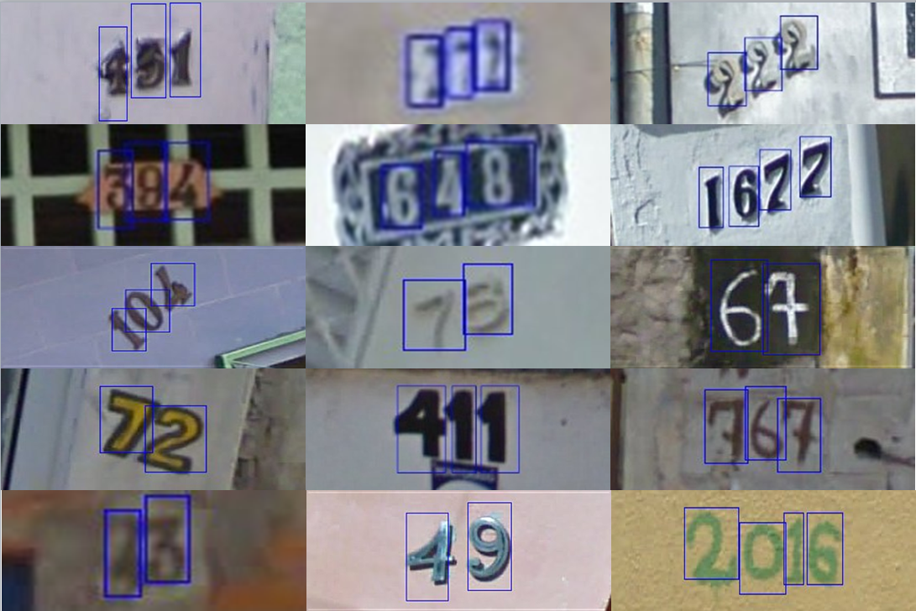
Dataset Description(Cont.)
Labels
10 classes for digits: '1' → 1, '9' → 9, '0' → 10 (not 0).
Each image may contain multiple digits.
Annotation Format
digitStruct.mat: Contains bounding box info per digit:
name: Image filename
bbox: Array of structs → height, width, label, top, left
Fig 1 : Sample Images

Slide 6
Preprocessing
Extracted Data from .tar.gz archives (train/test).
Parsed digitStruct.mat for filenames, bounding boxes, and digit labels.
Converted labels (10 → 0) and created structured CSV files.
Filled missing digits with -1 for consistency.
Visualizations
Digit length distribution.
Digit frequency.
Output: Clean CSVs ready for model training.

Slide 7
CNN Architectures
C
O
N
V
2D
M
A
X
P
O
O
L
C
O
N
V
2D
M
A
X
P
O
O
L
F
C
ReLu
ReLu
Pre-processing
Output
Architecture 1 - Custom Architecture
Pre-processing
ResNet18
(Removed FC)
Digit Classifier
Output
Architecture 2 - Modified Pretrained Architecture

Slide 8
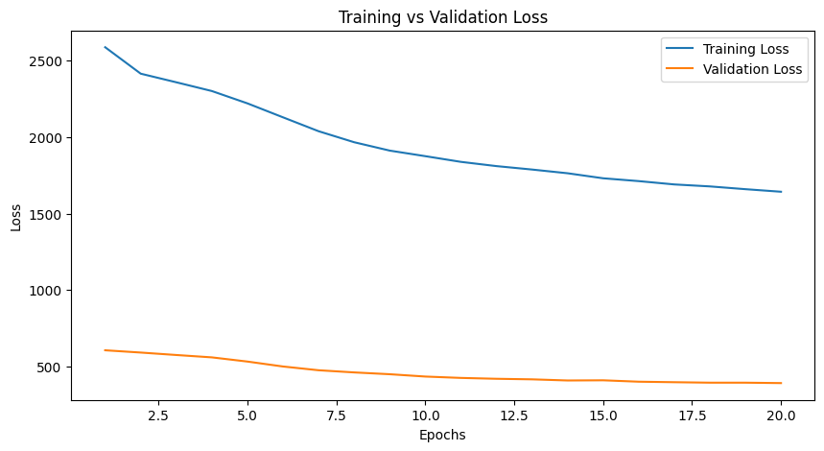
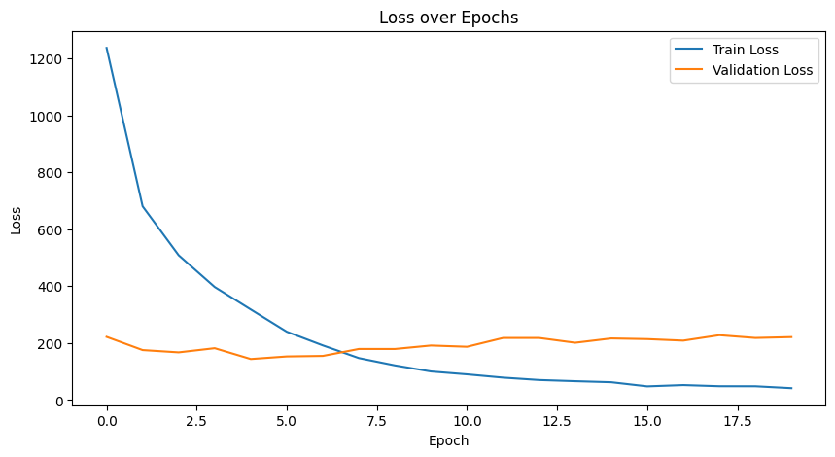
Results
Custom Architecture’s Epoch vs Loss Curve
ResNet Architecture’s
Epoch vs Loss Curve
Test Accuracy : 72.36%
Test Accuracy : 86.33%

